Slide 1
Introduction to
Knowledge Graphs
Ilaria Tiddi, KRW course

Slide 2
Let’s start with a definition...
“knowledge that is represented in some graph-like format, preferably machine readable, and used as the source of knowledge/information/data in some application”
“Knowledge graphs are often used to store interlinked descriptions of entities – objects, events, situations or abstract concepts – while also encoding the semantics underlying the used terminology.
“a data model based on three basic principles: encode knowledge using statements, express background knowledge in ontologies, reuse knowledge between datasets”
...there’s 24 (!) definitions more (at least…)
A Common Sense View of Knowledge Graphs: http://www.mkbergman.com/2244/a-common-sense-view-of-knowledge-graphs/
Notes:
Especially with a definition Not a real one - but structure (graph) & content (knowledge) are always there (( Note on the starts : they are refs & interesting readings ))

Slide 3


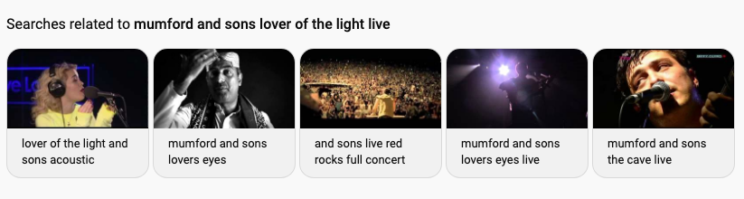
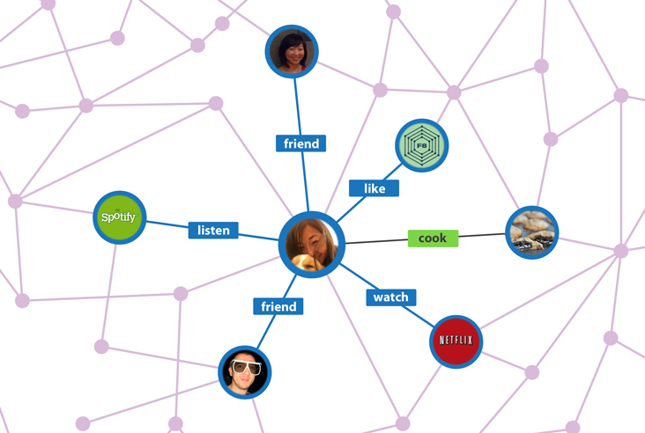
Ever seen a KG?
We see knowledge graphs
all the time
but we might not know it
Industry-scale Knowledge Graphs: Lessons and Challenges: https://queue.acm.org/detail.cfm?id=3332266
Notes:
OK definition, but what do we mean by KG? Who has never heard of KG? The truth...

Slide 4

Knowledge Graphs
and many more…
Adoption of Knowledge Graphs: https://www.slideshare.net/Frank.van.Harmelen/adoption-of-knowledge-graphs-mid-2019

Slide 5
The Semantic Web
Notes:
The q is how we got there?

Slide 6

A Knowledge Graph at Web-scale
“To a computer [...] the web is a flat, boring world devoid of meaning [...]”
“documents on the web [should] describe real objects and imaginary concepts, and give particular relationships between them.”
In other words, the Web needs semantics
The next Web (1994) : https://www.ted.com/talks/tim_berners_lee_on_the_next_web
Notes:
In 1994 TBL gives his talk ...

Slide 7
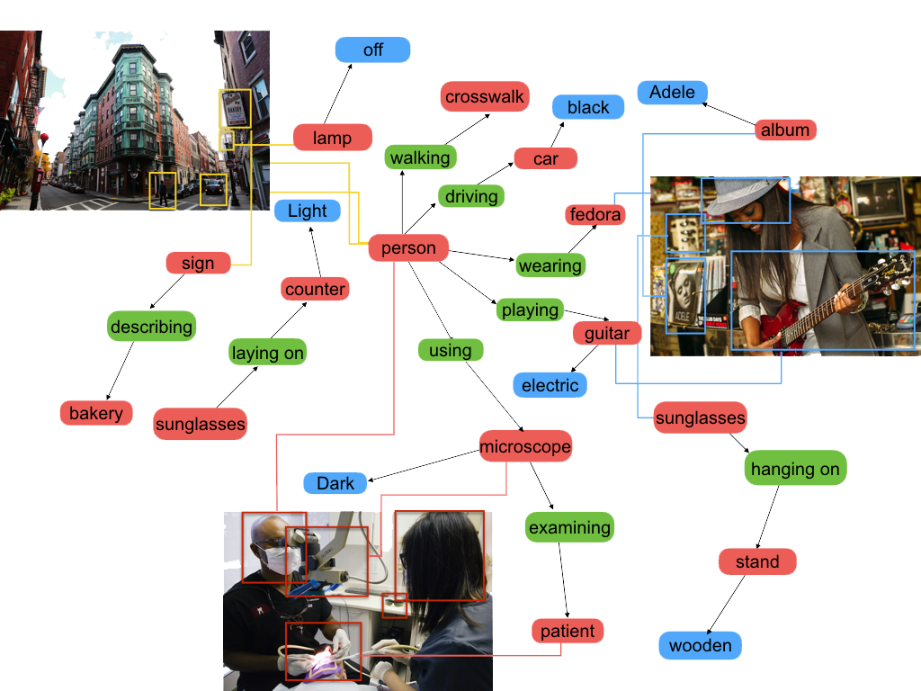
A Knowledge Graph at Web-scale
In 4 steps (the 4 principles of Linked Data)
Give everything a name
Credits : https://www.dropbox.com/s/lvc6lwzrvj9z2vf/ING2018.pptx?dl=0
Notes:
Proposes 4 principles: assign types to things (musician, sunglasses), Create relations (musician wears sunglasses), organise types in a hierarchy (musician > person), impose constraints on the possible interpretations (persons wear glasses)

Slide 8
A Knowledge Graph at Web-scale
In 4 steps (the 4 principles of Linked Data)
Give everything a name
Create relationships between things → you get a big graph
Credits : https://www.dropbox.com/s/lvc6lwzrvj9z2vf/ING2018.pptx?dl=0
Notes:
Proposes 4 principles: assign types to things (musician, sunglasses), Create relations (musician wears sunglasses), organise types in a hierarchy (musician > person), impose constraints on the possible interpretations (persons wear glasses)

Slide 9
A Knowledge Graph at Web-scale
In 4 steps (the 4 principles of Linked Data)
Give everything a name
Create relationships between things → you get a big graph
Make sure names are on the Web (they are URIs) → you get a big global graph
Credits : https://www.dropbox.com/s/lvc6lwzrvj9z2vf/ING2018.pptx?dl=0
Notes:
Proposes 4 principles: assign types to things (musician, sunglasses), Create relations (musician wears sunglasses), organise types in a hierarchy (musician > person), impose constraints on the possible interpretations (persons wear glasses)

Slide 10
A Knowledge Graph at Web-scale
In 4 steps (the 4 principles of Linked Data)
Give everything a name
Create relationships between things → you get a big graph
Make sure names are on the Web (they are URIs) → you get a big global graph
Add semantics (constraints to allow inference) → you get a knowledge graph
Credits : https://www.dropbox.com/s/lvc6lwzrvj9z2vf/ING2018.pptx?dl=0
Notes:
Proposes 4 principles: assign types to things (musician, sunglasses), Create relations (musician wears sunglasses), organise types in a hierarchy (musician > person), impose constraints on the possible interpretations (persons wear glasses)

Slide 11
RDF
Notes:
These are the principles, but let’s get formal

Slide 12
Resource Description Framework (RDF)
RDF: a language for representing information about resources in the Web.
Intended for situations in which information needs to be processed by machines, not (only) by people.
RDF Primer https://www.w3.org/TR/rdf-primer/
Notes:
To represent KG, we use RDF Idea :machines need to understand as much as people do

Slide 13
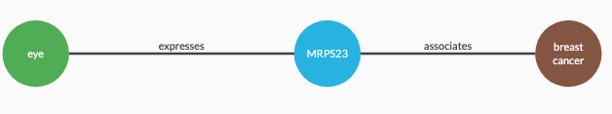
1. Create entities and relationships
In other words, triples A triple (s,p,o) is composed of:
subject: identifies the thing the statement is about (“gene MRP23”)
predicate: characteristic/property describing the subject (“associatedWith”)
object: the value of that property (“Breast Cancer”)
Notes:
We have resources, following the secondo principle -- we create relationships Rel are represented with triples (s,p,o) where

Slide 14
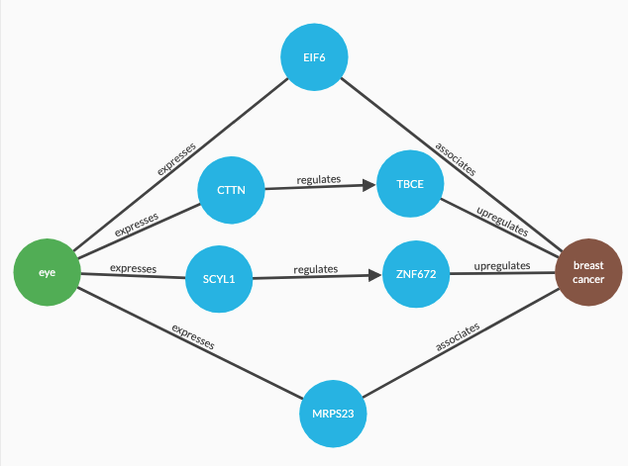
2. Create a graph
Many triples form a graph!
Notes:
We have resources, following the secondo principle -- we create relationships Rel are represented with triples (s,p,o) where

Slide 15
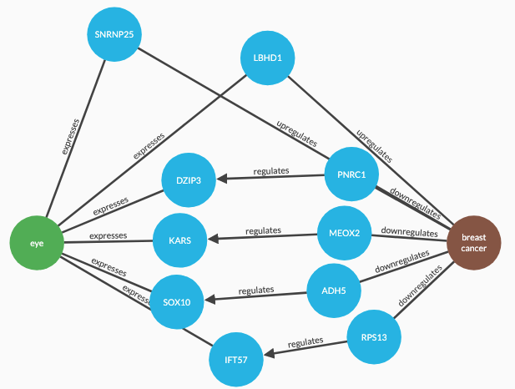
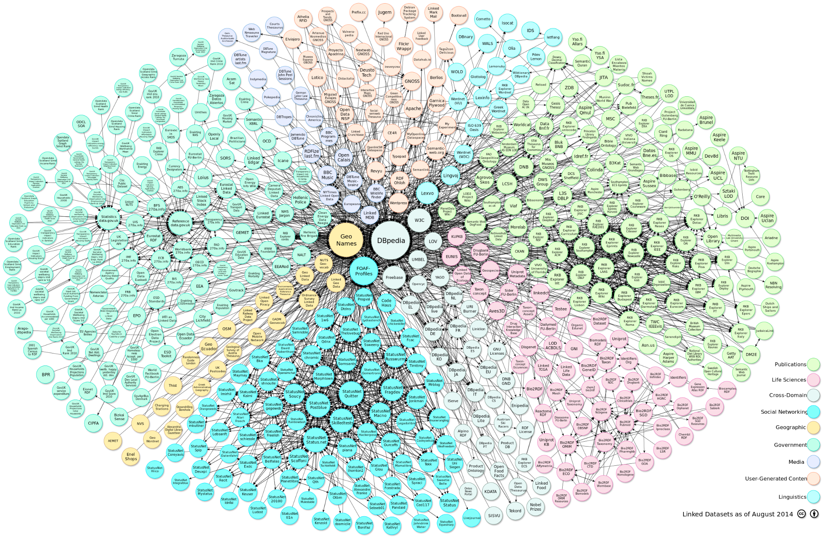
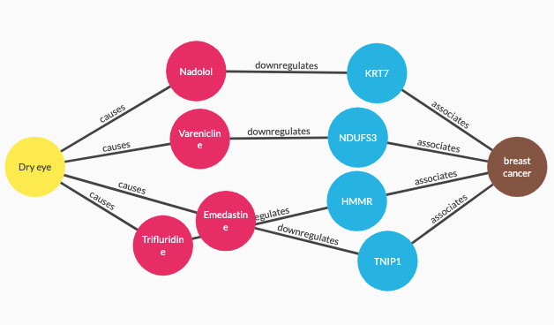
3. A global graph...
...
http://lod-cloud.net/
Notes:
Not only a graph but a global graph : this us the linked data initiative started in 2006

Slide 16

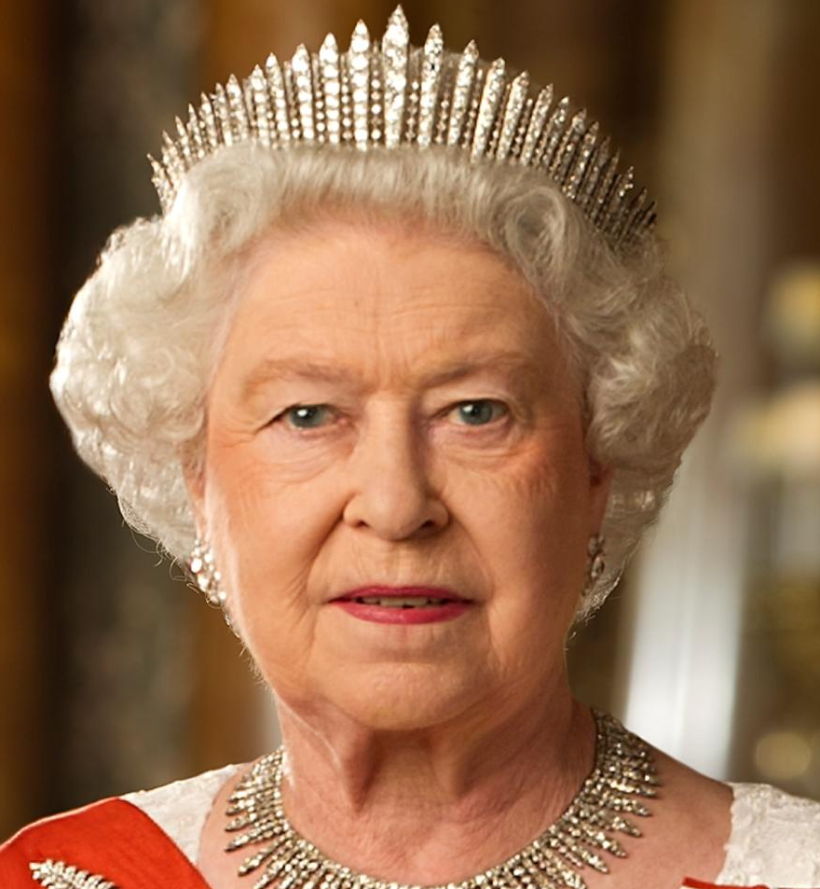

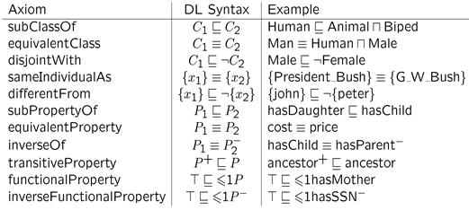
3. Add semantics with RDFS/OWL
Complement RDF syntax with formal semantics of RDFS and OWL:
RDF defines the syntax: how symbols are represented
RDFS and OWL add the semantics: what symbols actually mean.
For: enhancing representation, reasoning, interoperability of data
How to define the semantics of your domain?
queen regina königin khalessi
Notes:
Back to the principles… once we have triples and grpah we still have this problem of OWA the last step is to impose constraints For this RDFs complements… Think of the difference as

Slide 17
RDFS
Notes:
These are the principles, but let’s get formal

Slide 18
RDF Semantics: RDF Schema
A set of “special keywords” ( = a vocabulary) that allows to:
Specify that something is a class → :Teacher rdf:type rdfs:Class .
Specify that something is a subclass → :Teacher rdfs:subClassOf foaf:Person .
Specify that something is a property → :teachesCourse rdf:type rdfs:Property .
Specify that something is a subproperty → :teachesModule rdfs:subPropertyOf :teachesCourse .
Specify that something is an instance of a class → :ilaria rdf:type :Teacher .

Slide 19
RDF Semantics: RDF Schema
Constraining properties with certain classes
:Teacher :teachesCourse :Course . :teachesCourse rdfs:domain :Teacher . # class of the subject
:teachesCourse rdfs:range :Course . # class of the object
NB : inheritance of subproperties
:teachesModule rdfs:subPropertyOf :teachesCourse
means : :teachesModule rdfs:domain :Teacher .
:teachesModule rdfs:range :Course .
Notes:
Old slides : Classes
RDF:type, RDF:property
RDF: subclassOf
RDF domain and range
RDF subproperty of

Slide 20
RDF Semantics: RDF Schema
Give something a name →
dbo:Amsterdam rdfs:label “Amsterdam”@nl .
Give something a comment →
dbo:Amsterdam rdfs:comment “Fantastic city!” .
Refer to similar resources →
dbo:Amsterdam rdfs:seeAlso wikidata:Amsterdam .
Notes:
rdfs:seeAlso → helps pointing to to

Slide 21
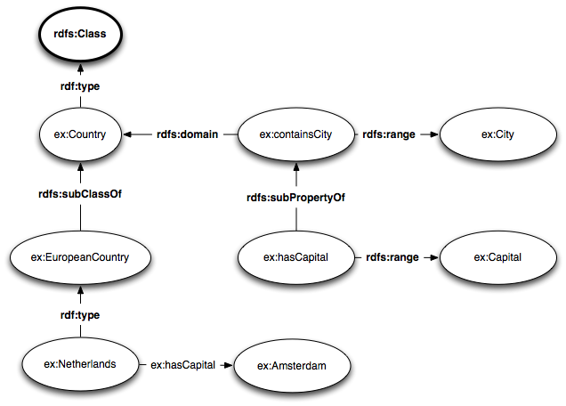
RDF Schema - Reserved Symbols

Slide 22
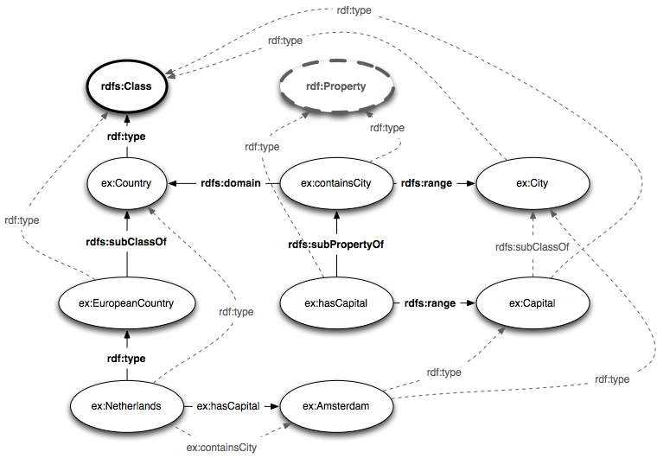
RDF Schema – the intended inferences
Notes:
When we run a reasoner: Straight edges → asserted triples = triples I declared ( = wrote) in my knowledge base Dashed edges → inferred triples = triples the reasoner comes up based on the asserted triples (using rdfs:subClass, rdf:type , domain and range for that…)
New inferences
ex:containsCity/hasCapital : recognised as rdf:Properties because their rdfs:domain and rdfs:range is asserted
ex:Capital : nothing was said about Capital because of they are in the range of a property (therefore they are classes) + rdfs:subClassOf because of the rdfs:subPropertyOf

Slide 23
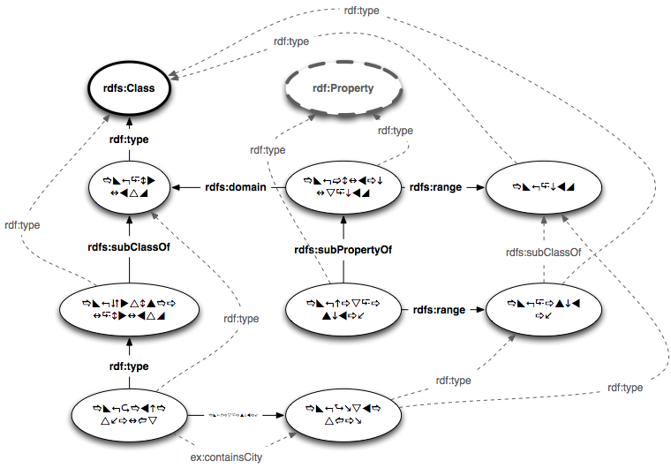
Formal Semantics - Based on form
The working of the reasoner does not depend on the syntax! No matter the symbols we use, the special keywords will be understood anyway

Slide 24
RDF Schema - The Levels
Ontology
Schema / TBox
Instances/
individuals
Data / ABox
Notes:
The inferences at ontology level are much more than the instances

Slide 25
OWL
Notes:
These are the principles, but let’s get formal

Slide 26


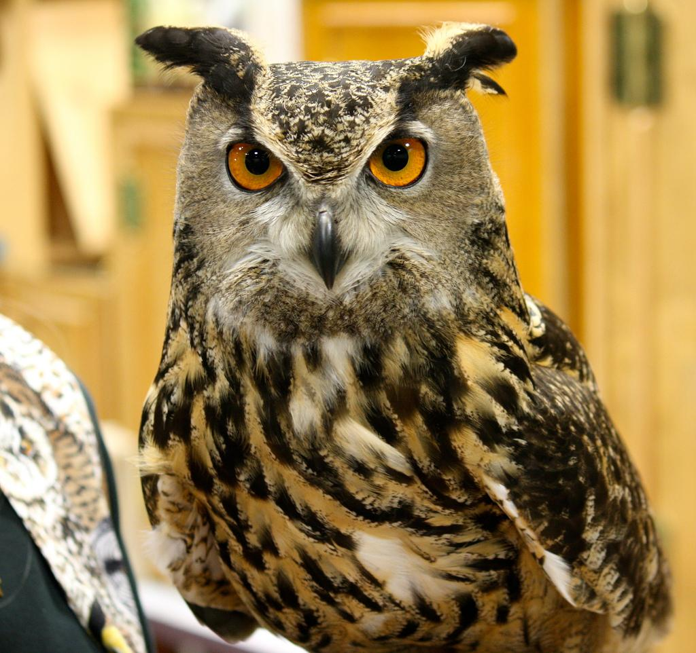
OWL: the Web Ontology Language
Keywords (= vocabulary) for extensively defining classes and properties
Built on Description Logics (DL)
Extension of RDFS semantics and syntax
Further Restrictions of RDFS semantics and syntax
Strict separation between instances, classes and properties

Slide 27
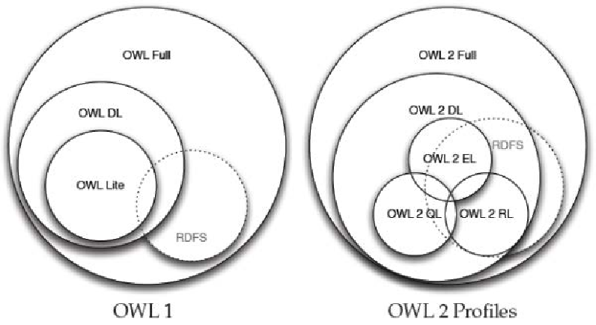
OWL: the Web Ontology Language
Uses vocabulary from RDF and RDFS
More expressive than RDFS
Two versions:
2004 : OWL-Lite, OWL-DL, OWL-Full
OWL Lite : limited (no owl:oneOf/owl:unionOf/owl:disjointWith …) but easier to use
OWL DL : DL-expressiveness , computational-expensive, almost complete
OWL Full : lot of freedom but computational-expensive
2009 : OWL EL, OWL QL, OWL RL

Slide 28
OWL - Property types
3 different types
Object Properties Properties of type owl:ObjectProperty have only non-literals as range, They are rdfs:subPropertyOf owl:topObjectProperty
Datatype Properties Properties of type owl:DatatypeProperty have only literals as range, They are rdfs:subPropertyOf owl:topDatatypeProperty
Annotation Properties Properties of type owl:AnnotationProperty cannot be used in restrictions
NB : These are disjoint properties : every property belongs to one of these categories

Slide 29
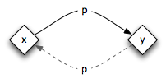
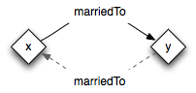
OWL - Symmetric properties
Used to specify that a property always holds in both directions
ex:p rdf:type owl:SymmetricProperty . ex:x ex:p ex:y . ex:y ex:p ex:x .
Asserted
Inferred

Slide 30
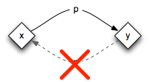
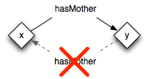
OWL - Asymmetric properties
Used to specify that a property never holds in both directions owl:differentFrom allows us to specify that two URIs denote a different individual!
ex:p rdf:type owl:AsymmetricProperty . ex:x ex:p ex:y . ex:y ex:p ex:x .
ex:x owl:differentFrom ex:x .
Asserted
inconsistent
Inferred

Slide 31
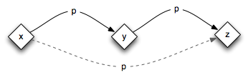
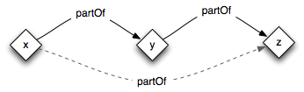
OWL - Transitive properties
Used to specify that a property propagates over itself
ex:p rdf:type owl:TransitiveProperty . ex:x ex:p ex:y . ex:y ex:p ex:z . ex:x ex:p ex:z .
Asserted
Inferred

Slide 32
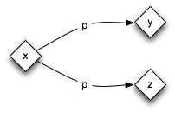
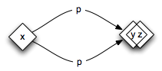
OWL - Functional properties
Specify that a property has only one value for any particular instance e.g. (X, hasMother, Y), (X, hasMother, Z) => (Y, sameAs, Z) owl:sameAs → specify that two URIs denote the same individual
ex:p rdf:type owl:FunctionalProperty . ex:x ex:p ex:y . ex:x ex:p ex:z . ex:y owl:sameAs ex:z .
Asserted
Inferred
Notes:
Subject can only have one of these objects

Slide 33
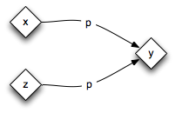
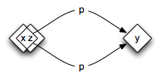
OWL - Inverse Functional properties
specify a value for the property uniquely identifies an instance e.g. (X, isMotherOf, Y), (Z, isMotherOf, Y) => (X, sameAs, Z) owl:sameAs → specify that two URIs denote the same individual
ex:p rdf:type owl:InverseFunctionalProperty . ex:x ex:p ex:y . ex:z ex:p ex:y . ex:x owl:sameAs ex:z .
Asserted
Inferred
Notes:
Object can only have one of these objects

Slide 34
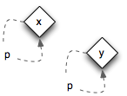
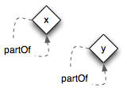
OWL - Reflexive properties
Used to specify that every individual is always related to itself by that property
ex:p rdf:type owl:ReflexiveProperty . ex:x ex:p ex:x .
Asserted
Inferred

Slide 35
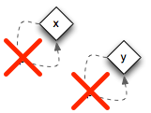
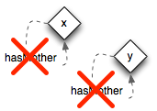
OWL - Irreflexive properties
Used to specify that no individual is ever related to itself via that property
Remember the use of owl:differentFrom
Asserted
ex:p rdf:type owl:IrreflexiveProperty . ex:x ex:p ex:x .
ex:x owl:differentFrom ex:x .
inconsistent
Inferred

Slide 36
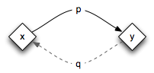
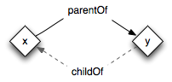
OWL - Inverse properties
Used to specify that one property is always the inverse of another property
Asserted
ex:p owl:inverseOf ex:q . ex:x ex:p ex:y . ex:y ex:q ex:x .
Inferred

Slide 37
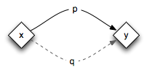
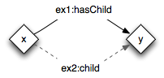
OWL - Equivalent properties
Used to specify that two properties always co-occur
ex:p owl:equivalentProperty ex:q . ex:x ex:p ex:y . ex:x ex:q ex:y .
Asserted
Inferred

Slide 38
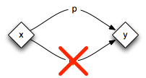
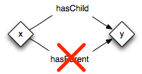
OWL - Disjoint properties
Used to specify that two properties never co-occur
ex:p owl:disjointProperty ex:q . ex:x ex:p ex:y . ex:x ex:q ex:y .
Asserted
inconsistent
Inferred

Slide 39
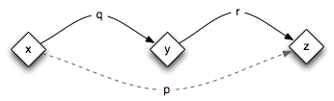
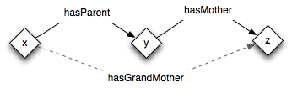
OWL - Property chains
Properties that propagate over a chain of other properties
Use brackets in Turtle syntax to specify a list.
ex:p owl:propertyChainAxiom (ex:q ex:r) . ex:x ex:q ex:y . ex:y ex:r ex:z . ex:x ex:p ex:z .
Asserted
Inferred

Slide 40
OWL - Classes
Every class is of type owl:Class (and only rdfs:Class by transitivity)
Every class is automatically a subclass of owl:Thing
Every individual is of type owl:NamedIndividual (and of owl:Thing)
No individual is of type owl:Nothing (empty set, automatically disjoint with other classes)
No class is a subclass of owl:Nothing
Only used to indicate inconsistency

Slide 41
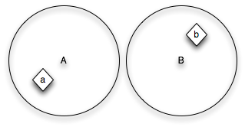
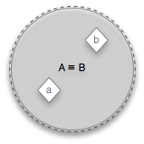
OWL Class Axioms - Equivalence and Complement
Equivalent classes contain the same individuals, and have the same definition
ex:A owl:equivalentClass ex:B . ex:a rdf:type ex:A . ex:b rdf:type ex:B . ex:a rdf:type ex:B . ex:b rdf:type ex:A .
Asserted
Inferred
Notes:
<foaf:Person owl:equivalentClass krw:Person>

Slide 42
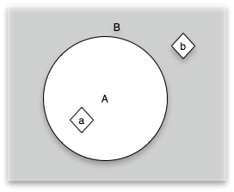
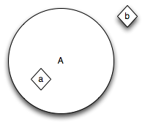
OWL Class Axioms - Equivalence and Complement
The complement of a class contains all individuals that are not in that class
(NB: The complement of a class is all of owl:Thing that the class is not, e.g. “all females are not males”)
ex:B owl:complementOf ex:A . ex:b rdf:type owl:Thing . ex:b rdf:type ex:B .
Asserted
E.g. ex:LivingHuman owl:complementOf ex:DeadHuman.
Inferred
Notes:
If you don’t specify the class, it will appear in the complement

Slide 43
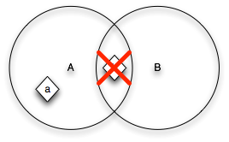
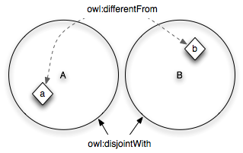
OWL Class Axioms - Disjointness
Disjoint classes do not contain the same individuals The complement and disjointness allow us to infer that individuals are different.
ex:A owl:disjointWith ex:B . ex:a rdf:type ex:A . ex:b rdf:type ex:A, ex:B .
ex:Man owl:disjointWith ex:Woman . ex:x rdf:type ex:Man . ex:y rdf:type ex:Woman . ex:x owl:differentFrom ex:y .
inconsistent

Slide 44
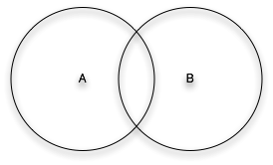
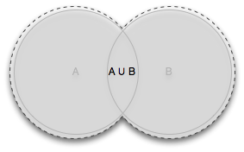
OWL Class Axioms - Union, Disjoint Union
The union contains all individuals that belong to the classes of the union
ex:C owl:unionOf ( ex:A ex:B ). ex:a rdf:type ex:A . ex:b rdf:type ex:B . ex:a rdf:type ex:C . ex:b rdf:type ex:C .
ex:Girl owl:unionOf ( ex:Female ex:Woman ) .
Notes:
An instance of one class is also in two other classes every femal is both Girl and Woman

Slide 45
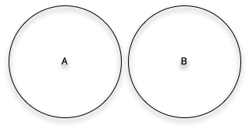
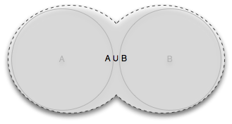
OWL Class Axioms - Union, Disjoint Union
A disjoint union is a union of mutually disjoint classes
ex:C owl:disjointUnionOf ( ex:A ex:B ). ex:a rdf:type ex:A . ex:a rdf:type ex:B .
inconsistent
ex:Child owl:disjointUnionOf ( ex:Boy ex:Girl ) .
Notes:
An instance of one class is also in one of these other classes but not both

Slide 46
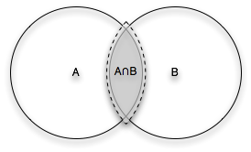
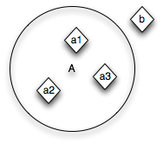
OWL Class Axioms - Intersection, Enumeration
The intersection contains individuals that each belong to both classes
you can enumerate all members of a class
ex:C owl:intersectionOf (ex:A ex:B ). ex:a rdf:type ex:A . ex:a rdf:type ex:B . ex:a rdf:type ex:C .
ex:A owl:oneOf ( ex:a1 ex:a2 ex:a3 ) . ex:a1 rdf:type owl:Thing . ex:a1 rdf:type ex:A .
owl:Sex owl:oneOf ( ex:male, ex:female )

Slide 47
OWL - Necessary & sufficient conditions
Describe describe a implicational relationship between two statements, e.g. “If X, then Y”
Necessary condition (if)
X is necessary condition for Y ( X => Y )
consequent Y must be true if X is to be true
e.g.: Having a Msc is a necessary condition (but not sufficient) for being a PhD student
Sufficient condition (if)
X is sufficient condition for Y (X <= Y)
if X is true, the consequent Y must be true
Stronger than necessary condition
Example: Being a PhD is a sufficient condition for having a MSc (but not necessary)
Necessary and sufficient condition (iff)
Both (X <= Y) and ( X => Y) hold

Slide 48
OWL - Necessary & sufficient
Necessary (“if”) class restrictions use rdfs:subClassOf to
Infer subclass relations
Infer property values of known class members
E.g.:
All persons have a mother
Female is subclass of Person
→ All females have a mother

Slide 49
OWL - Necessary & sufficient
Necessary and sufficient (“iff”) class restrictions use owl:equivalentClass to
Infer class equivalence
Infer class membership of individuals
E.g.:
Wine equivalent to FermentedGrapeJuice
Cune is a wine
→ Cune is a FermentedGrapeJuice

Slide 50
OWL - Existential (some)
All members of a class have at least one value from the specified class
ex:NobelPrizeWinners rdfs:subClassOf ex:Person ; owl:equivalentClass [ rdf:type owl:Restriction ; owl:onProperty ex:won ; owl:someValuesFrom ex:NobelPrize ] . ex:marieCurie ex:won ex:physicsNobelPrize1903 . ex:physicsNobelPrize1903 rdf:type ex:NobelPrize . ex:marieCurie rdf:type ex:NobelPrizeWinner .
"NobelPrizeWinners is exactly the class of all Persons who have won at least one NobelPrize"

Slide 51
OWL - Universal (all)
All members of a class have only values from the specified class (all)
ex:NobelPrize rdfs:subClassOf ex:Prize ; rdfs:subClassOf [ rdf:type owl:Restriction ; owl:onProperty ex:wonBy ; owl:allValuesFrom ex:NobelPrizeWinner ] . ex:physicsNobelPrize1903 ex:wonBy ex:marieCurie . ex:physicsNobelPrize1903 rdf:type ex:NobelPrize . ex:marieCurie rdf:type ex:NobelPrizeWinner .
"A NobelPrize can only be wonBy a NobelPrizeWinner"
Notes:
allValuesFrom and someValuesFrom differ in the sense that the first requires all values of the property values, the latter at least one to be of a certain class.
:Person a owl:Class ; rdfs:subClassOf [ a owl:Restriction ; owl:onProperty :hasParent ; owl:allValuesFrom :Person ] .

Slide 52
OWL - Universal (all)
All members of a class have only values from the specified class (all)
ex:Human rdfs:subClassOf [ rdf:type owl:Restriction ; owl:onProperty ex:hasParent ; owl:allValuesFrom ex:Human ] . ex:lise ex:hasParent ex:anja . ex:lise rdf:type ex:Human . ex:anja rdf:type ex:Human .
"A human can only be have a parent that is a human"
Notes:
allValuesFrom and someValuesFrom differ in the sense, that the first requires all values of the property values, the latter at least one to be of a certain class.
:Person a owl:Class ;
rdfs:subClassOf [ a owl:Restriction ;
owl:onProperty :hasParent ;
owl:allValuesFrom :Person ] .

Slide 53
OWL - Value
All members of a class have only values from the specified class (all)
ex:FiatUno rdfs:subClassOf ex:Car ; rdfs:subClassOf [ rdf:type owl:Restriction ; owl:onProperty ex:hasModel ; owl:hasValue ex:fiatUnoModel ] . ex:myCar rdf:type ex:FiatUno . ex:myCar ex:hasModel ex:fiatUnoModel .

Slide 54
OWL - Value
All members of a class have only values from the specified class (all)
ex:RedCar rdfs:subClassOf ex:Car ; rdfs:subClassOf [ rdf:type owl:Restriction ; owl:onProperty ex:hasColour ; owl:hasValue ex:red ] . ex:myCar rdf:type ex:RedCar . ex:myCar ex:hasColour ex:red .

Slide 55
OWL - Cardinality
All members of a class have exactly/min/max n values (from the specified class)
ex:Mammal rdfs:subClassOf [ rdf:type owl:Restriction ; owl:onProperty ex:hasParent ; owl:qualifiedCardinality ”2”^^xsd:integer ; owl:onClass ex:Parent ] . ex:a ex:hasParent ex:p1, ex:p2 . #all instances of ex:Parent (all different) ex:a rdf:type ex:Mammal .

Slide 56
OWL - Cardinality
All members of a class have exactly/min/max n values Also with Datatypes
:Person rdfs:subClassOf [
rdf:type owl:Restriction;
owl:qualifiedCardinality ”1”^^xsd:integer;
owl:onProperty :hasAge;
owl:onDataRange xsd:integer
].
ex:a ex:hasAge “33”^^xsd:integer, “34”^^xsd:integer INCONSISTENT

Slide 57
OWL - Local reflexivity
All members of a class have a relation with themselves
ex:A rdfs:subClassOf [ rdf:type owl:Restriction ; owl:onProperty ex:p ; owl:hasSelf ”true”^^xsd:boolean ] . ex:a rdf:type ex:A . ex:a ex:p ex:a .

Slide 58
OWL - Identity and Negation
State that two individuals are different or the same.
You can say that a property does not hold between two individuals
ex:a owl:sameAs ex:b, ex:c ; owl:differentFrom ex:d . ex:b owl:sameAs ex:a, ex:c ; owl:differentFrom ex:d . ex:c owl:sameAs ex:a, ex:d ; owl:differentFrom ex:d .
_:x rdf:type owl:NegativePropertyAssertion ; owl:sourceIndividual ex:a ; owl:assertionProperty ex:p ; owl:targetIndividual ex:b .

Slide 59
SPARQL (querying)
Notes:
Last part : how do we get information out of RDF?

Slide 60
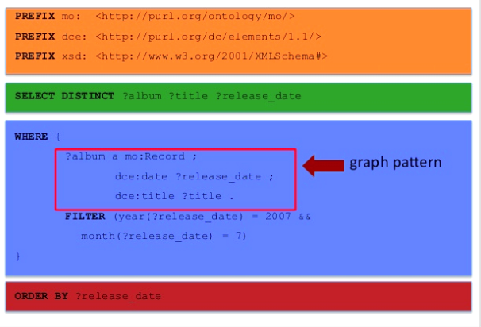
SPARQL
The protocol & query language for RDF
Prologue : Declarations used throughout the query.
Query Clause : What do we want to get back
Where Clause: Specifies the parts of the graph we are looking for
Modifiers: Perform operation to restrict results
Notes:
in a nutshell ...
Not too much details now, just an overview - Besides the prologue (prefixes) Query clase = what you want back Where = part of the graph Modifiers = to restrics

Slide 61
SPARQL forms
4 clause forms
Ask: Graph → Y/N (boolean answer)
Construct : Graph → Graph
Describe: IRIs → Graph
Select: Graph → Table
Notes:
in a nutshell ...
Not too much details now, just an overview - Besides the prologue (prefixes) Query clase = what you want back Where = part of the graph Modifiers = to restrics

Slide 62
SELECT - graph patterns
1 triple pattern 1 variable
SELECT ?subj WHERE {
?subj a <http://example.org/Teacher> .
}
Result :
rdf:type
ex:City
ex:Amsterdam
ex:Person
rdf:type
ex:lives
rdfs:subClassOf
ex:bornIn
rdf:type
ex:Rome
ex:ilaria
ex:Teacher
ex:likes
rdf:type
ex:biffy_clyro
ex:RockBand
rdfs:subClassOf
subj
ex:ilaria
Variable
binding
ex:Band
Notes:
Take a graph example 1 variable Result ?

Slide 63
SELECT - graph patterns
1 triple pattern 2 variables
SELECT ?subj ?obj WHERE {
?subj <http://example.org/bornIn> ?obj .
}
Result :
rdf:type
ex:City
ex:Amsterdam
ex:Person
rdf:type
ex:lives
rdfs:subClassOf
ex:bornIn
rdf:type
ex:Rome
ex:ilaria
ex:Teacher
ex:likes
rdf:type
ex:biffy_clyro
ex:RockBand
rdfs:subClassOf
subj | obj
ex:ilaria | ex:Rome
ex:Band
Notes:
Take a graph example 1 variable Result ?

Slide 64
SELECT - graph patterns
2 triple patterns 1 variable PREFIX ex: <http://example.org/> SELECT ?subj ?obj WHERE {
?subj a ex:Teacher ;
ex:bornIn ex:Rome .
}
Result :
rdf:type
ex:City
ex:Amsterdam
ex:Person
rdf:type
ex:lives
rdfs:subClassOf
ex:bornIn
rdf:type
ex:Rome
ex:ilaria
ex:Teacher
ex:likes
rdf:type
ex:biffy_clyro
ex:RockBand
rdfs:subClassOf
subj
ex:ilaria
ex:Band
Notes:
Take a graph example 1 variable Result ?

Slide 65
SELECT - graph patterns
2 triple patterns 2 variables PREFIX ex: <http://example.org/> SELECT ?subj ?place WHERE {
?subj a ex:Teacher ;
ex:bornIn ?place .
}
Result :
rdf:type
ex:City
ex:Amsterdam
ex:Person
rdf:type
ex:lives
rdfs:subClassOf
ex:bornIn
rdf:type
ex:Rome
ex:ilaria
ex:Teacher
ex:likes
rdf:type
ex:biffy_clyro
ex:RockBand
rdfs:subClassOf
subj | place
ex:ilaria | ex:Rome
ex:Band
Notes:
Take a graph example 1 variable Result ?

Slide 66
SELECT - graph patterns
2 triple patterns 1 hidden variable PREFIX ex: <http://example.org/> SELECT ?subj WHERE {
?subj a ex:Teacher ;
ex:bornIn ?place .
}
Result :
rdf:type
ex:City
ex:Amsterdam
ex:Person
rdf:type
ex:lives
rdfs:subClassOf
ex:bornIn
rdf:type
ex:Rome
ex:ilaria
ex:Teacher
ex:likes
rdf:type
ex:biffy_clyro
ex:RockBand
rdfs:subClassOf
subj
ex:ilaria
ex:Band
Notes:
Take a graph example 1 variable Result ?

Slide 67
SELECT - graph patterns
Many triple patterns (full subgraph) * = return all variables PREFIX ex: <http://example.org/> SELECT * WHERE {
?subj a ?type ;
ex:bornIn ?place ;
ex:livesIn ?place2 ;
ex:likes ?band .
?band a ex:RockBand .
}
Result?
rdf:type
ex:City
ex:Amsterdam
ex:Person
rdf:type
ex:lives
rdfs:subClassOf
ex:bornIn
rdf:type
ex:Rome
ex:ilaria
ex:Teacher
ex:likes
rdf:type
ex:biffy_clyro
ex:RockBand
rdfs:subClassOf
ex:Band
Notes:
Take a graph example 1 variable Result ?

Slide 68
SELECT - graph patterns
Many triple patterns (full subgraph) All variables PREFIX ex: <http://example.org/> SELECT * WHERE {
?subj a ?type ;
ex:bornIn ?place ;
ex:livesIn ?place2 ;
ex:likes ?band .
?band a ex:RockBand .
}
Result:
rdf:type
ex:City
ex:Amsterdam
ex:Person
rdf:type
ex:lives
rdfs:subClassOf
ex:bornIn
rdf:type
ex:Rome
ex:ilaria
ex:Teacher
ex:likes
rdf:type
ex:biffy_clyro
ex:RockBand
rdfs:subClassOf
subj | type | place | place2 | band
ex:ilaria | ex:Teacher | ex:Rome | ex:Amsterdam | ex:biffy_clyro
ex:Band
Notes:
Take a graph example 1 variable Result ?

Slide 69
SELECT - graph patterns
“800,000”
ex:population
Many triple patterns (full subgraph) All variables PREFIX ex: <http://example.org/>
SELECT ?city WHERE {
?city a ex:City ;
ex:population ?pop .
FILTER (?pop >= 1000000)
}
Result:
rdf:type
ex:City
ex:Amsterdam
ex:Person
rdf:type
ex:lives
rdfs:subClassOf
ex:bornIn
rdf:type
ex:Rome
ex:ilaria
ex:Teacher
ex:likes
ex:population
rdf:type
“3,000,000”
ex:biffy_clyro
ex:RockBand
rdfs:subClassOf
city
ex:Rome
ex:Band
Notes:
Take a graph example 1 variable Result ?

Slide 70
ASK queries
“800,000”
ex:population
PREFIX ex: <http://example.org/>
ASK {
?city ex:population 4000000
}
Result: ❌
PREFIX ex: <http://example.org/>
ASK {
?city ex:population 3000000
}
Result: ✓
rdf:type
ex:City
ex:Amsterdam
ex:Person
rdf:type
ex:lives
rdfs:subClassOf
ex:bornIn
rdf:type
ex:Rome
ex:ilaria
ex:Teacher
ex:likes
ex:population
rdf:type
“3,000,000”
ex:biffy_clyro
ex:RockBand
rdfs:subClassOf
ex:Band
Notes:
Take a graph example 1 variable Result ?

Slide 71
CONSTRUCT query
“800,000”
ex:population
rdf:type
ex:City
ex:Amsterdam
ex:Person
Translate a matched subgraph into a graph with a new shape
PREFIX ex: <http://example.org/>
CONSTRUCT {
?subj ex:livedIn ?city.
?city a ex:BigCity
} WHERE {
?subj a ex:Teacher. ?subj ?pred ?city .
?city ex:population ?pop .
FILTER (?pop >= 1000000)
}
Result
rdf:type
ex:lives
rdfs:subClassOf
ex:bornIn
rdf:type
ex:Rome
ex:ilaria
ex:Teacher
ex:population
“3,000,000”
ex:ilaria
ex:livedIn
ex:Rome
rdf:type
ex:BigCity
Notes:
Take a graph example 1 variable Result ?

Slide 72

SPARQL - other modifiers
SPARQL specification : https://www.w3.org/TR/sparql11-query/

Slide 73

SPARQL - additional features
SPARQL specification : https://www.w3.org/TR/sparql11-query/

Slide 74
SPARQL - Useful tutorials
https://presentations.triply.cc/training/querying-knowledge-graphs.html
https://www.slideshare.net/vdeboer/intro-to-linked-dutch-ships-and-sailors-and-sparql-handson
https://www.dropbox.com/home/KR%20on%20the%20Web%202018?preview=krw-sparql-overview.pdf
Notes:
filter

Slide 75
Ontology engineering
Notes:
Last part : how do we get information out of RDF?

Slide 76

From knowledge to ontology engineering
How to build a real ontology?
Explicit = formal, machine interpretable language (RDF,RDFS,OWL)
Shared = open on the web (HTTP, URIs)
Conceptualisation = classes, instances and relations (design decisions)
Context = tied to a particular domain/task (ontology commitment)
“An ontology is an explicit specification of a shared conceptualisation that holds in a particular context”

Slide 77
Methods for KG creation
Human collaboration
Domain-experts + Knowledge Engineers
Editors
Crowdsourcing, collaborative-editing
high costs
Information/Knowledge Extraction from text
Markup Extractors
web tables, html tags, etc.
Structured sources
tables, mapping other KGs

Slide 78
Ontology Engineering Methodology
Steps: (see also McGuinness and Noy)
Determine domain & scope
Consider reuse
Enumerate terms
Define a taxonomy
Define the properties
Define classes and their properties (domain/range, restrictions, hierarchies)
Define instances
Check for anomalies (run the reasoner)
NB : not a linear process, but iterative!

Slide 79

Determine Domain and Scope
Domain: geography
Application: route planning agent
Scope through Competency Questions
Natural language questions illustrating the information that one wants the ontology to answer.
Distance between two cities? What sort of connections exist between two cities? In which country is a city? How many borders are crossed?

Slide 80

2. Consider reuse
Lots of resources available, no need to start from scratch
Vocabularies (ontologies, schemas)
Schema.org : https://schema.org/docs/full.html
Dublin Core Metadata : http://www.dublincore.org/specifications/dublin-core/dcmi-terms/
VOID : https://www.w3.org/TR/void/
DCAT: https://www.w3.org/TR/vocab-dcat-2/
FOAF : http://xmlns.com/foaf/spec/20070114.html
Ontology Design Patterns http://ontologydesignpatterns.org
SKOS Core Vocabulary
https://www.w3.org/TR/swbp-skos-core-spec/
Linked Open Vocabularies :
https://lov.linkeddata.es/dataset/lov

Slide 81

2. Consider reuse
Lots of resources available, no need to start from scratch
Ontologies + Data (schemas + instances)
TriplyDB : https://triplydb.com/
Google Dataset search : https://datasetsearch.research.google.com/
Linked Open Data Cloud https://lod-cloud.net
Laundromat/LOD-a-LOT : http://lod-a-lot.lod.labs.vu.nl/
Datahub.io : https://datahub.io/
Open-domain datasets :
DBpedia, Wikidata, YAGO (Billions of Triples)
NELL, ConceptNet, KBpedia (more instances than ontologies)

Slide 82

2. Consider reuse
Lots of resources available, rarely start from scratch
Domain specific resources
Linguistic resources : http://linguistic-lod.org/, Wordnet, BabelNet, FrameSter…
Geography : Geonames
Robotics& IoT: http://lov4iot.appspot.com/
Biomedicine: BIORDF, SNOMED, Bioportal, MESH, GeneOntology, Hetionet
Statistics: StatoOntology
Publications: Springer’s SciGraph, CrossRef, OpenCitations

Slide 83
3. Enumerate terms
city
capital
connection
Write an unstructured list all the relevant terms
Nouns form the basis for class names
Verbs form the basis for property names
Roughly structure terms using traditional Knowledge Engineering methods
Laddering (Organizing entities in a hierarchy)
Card sorting (grouping)
20 questions (determining main properties)
Connection_on_water
currency
country
Connection_on_land
road
Connection_in_air
border
railway
city
connection
capital
Connection_on_water
currency
country
Connection_on_land
road
Connection_in_air
border
railway

Slide 84

4. Define a taxonomy
Organise terms in a taxonomic hierarchy
Top-down
bottom-up
Ensure that hierarchy is indeed a taxonomy
If A is a subclass of B, then every instance of A must also be an instance of B

Slide 85
5. Define properties
Attaching properties to classes
Provide statements about the domain and range (rdfs:domain, rdfs:range)
Geographic_Entity
endPoint
Connection
startPoint
City
Country
bordersWith
capitalOf
hasCapital
Capital_City

Slide 86
6. Define Class and Property Restrictions
Define your constraints, eg
Cardinality: Country can have multiple borders (bordersWith), a connection only one point (startPoint)
Domain and Range of bordersWith is the class Country
Symmetry : if A bordersWith B, B also bordersWith A
Transitivity : if A.hasConnection(B), and B.hasConnection(C) => A.hasConnection(C)
Geographic_Entity
endPoint
Connection
City
Country
bordersWith
capitalOf
hasCapital
Capital_City

Slide 87
6. Define Class and Property Restrictions
A recap of OWL restrictions
Transitive properties
Example: colleague
Counter-example: friend
Symmetric properties
Example: friend
Counter-example: son
Functional properties
Example: mother
Counter-example: sister
Person 1
Person 2
Person 3
Person 1
Person 2
Person 2
Person 1
Person 3

Slide 88
7. Define Instances
After creating the ontology, fill the KG with instances
Number of instances >> number of classes
Ontology Population is never done (fully) manually (next session on IE)
Retrieved from data sources (DBs)
Extracted automatically from a text corpus
mixed-methods

Slide 89
8. Check for Consistency
A (semantic) reasoner or reasoning engine
typical KR technique
check consistency of an ontology
infer logical consequences from a set of asserted facts or axioms
In practice : a reasoner takes as input the triples you asserted (asserted KG), and generates new inferred triples (inferred KG)
e.g. new reclassing instances to a new class, classes to new superclasses
Often built-in reasoners in your tools (HermiT, Pellet, FACT++)

Slide 90

8. Check for Consistency
Quiz
How many triples are there in the asserted graph? How many in the inferred graph?

Slide 91
Publishing an ontology
Choose a format (ttl, rdf, n3 etc)
Document it (let the other know the content of your ontology)
Publish it on the web!
How do I choose a URI ? See this : https://www.w3.org/Provider/Style/URI
Evaluate (determine adequacy)
Methods: CQs, Expert-based evaluations
Measures
Accuracy (syntactic, semantic, timeliness)
Coverage (completeness, representativeness)
Coherency (validity, consistency)
Succinctness (understandability, conciseness)
Notes:
Chapter 7

Slide 92
Some tips
Make sure your ontology answer basic questions
which domain the ontology will cover? What will its use be?
What types of questions should the ontology answer?
Who will use and maintain the ontology?”
Make a list of classes, properties and instances you are planning to use
Define each class:
Specify necessary & sufficient conditions (owl:someValuesFrom, owl:hasValue);
Specify additional necessary conditions using any type of restriction;
Use disjointness and complement only sparingly;
Test whether the class “works” by specifying a test instance

Slide 93

More practical : Protégé
UI to design & create an ontology from scratch
Good tutorials:
Protégé tutorial
Pizza in 10 mins (Protégé version 4)
Protégé tutorial (Protégé version 3)
Do you prefer Python? Check the OWLready library and this notebook
Notes:
Here quick overview of Protege

Slide 94
Reusing Knowledge Graphs
Notes:
Last part : how do we get information out of RDF?

Slide 95



Querying Graphs
1. Dereferencing : copies one entity in the graph
2. SPARQL : SQL-like language for portions of the graph
3. Dump : local copy of the whole graph
Notes:
3 ways
Deref we saw it before SAPRQl we will see in a bit

Slide 96
Reusing Knowledge Graphs
Hubs of Datasets:
Google Dataset Search
Linked Open Data Cloud
Open-domain datasets:
DBpedia, Wikidata, YAGO
NELL, ConceptNet
Biomedical domain:
BIORDF, SNOMED, Bioportal
SNOMED, MESH, GeneOntology
Hetionet

Slide 97

A practical example : Hetionet
50 years of biomedical research
29 different datasets (eg DOID, UMLS, and DrugBank)
genes, compounds, diseases, anatomy, symptoms…
11 node types and 24 edge types
47k nodes and ~2M relationships

Slide 98
Conclusions
Notes:
To conclude I just wanted to give an overview… We saw a lot and this is just the tips of the iceberg, but perhaps I can give an overview

Slide 99
Lesson learnt from the practice
Knowledge graphs are scalable
across size, across heterogeneity, across locations, across organisations
A little semantics goes a long way
A good enough ontology now is better than perfect large ontology
Do not forget the task dependence
Your model (“ontology”) depends on what you will use it for
No ultimate ontology for a domain exists

Slide 100
Open challenges
Knowledge acquisition & fusion
Growth: knowledge graphs are incomplete
Validation: knowledge graphs are not always correct
Access: how to make it easier to access knowledge?
Intelligence: can AI emerge from knowledge graphs?
How to use KG data for ML?

